Slide 1
Online Multi-Person Tracking with DCNN based Online Appearance Model Learning NICOP/ARL Project Midyear Review (@ARL, Adelphi, MD)
2017. Apr. 25
PI: Hanseok Ko (Korea University)

Slide 2
Table of Contents
Research Overview
Introduction & Background
Research Progress
Experiments & Demo
Further Works

Slide 3
Research Overview
Procedure of the project
Task 1: Develop the visual-based online multi-person tracking algorithm
Data association
Finding optimal assignments between detections and targets to sequentially build people trajectories
Online appearance modeling
Representing target appearances based on CNNs to discriminate different people, thereby providing accurate appearance affinities to guide reliable data association
Re-identification
Recognition of people who re-enter the field of view using the proposed appearance models
Data association
Online appearance modeling
Re-
identification
Audio source localization
Fusion strategy incorporating local targets
Task 2: Audio-visual based multi-speaker tracking
Task 1: Visual-based online multi-person tracking
Completed

Slide 4
Research Overview
Procedure of the project
Task 2: Develop the audio-visual multi-speaker tracking algorithm
Audio source localization
Angular spectrum function and Sensor selectively clustering algorithm
Fusion strategy incorporating local target information
Multi-level framework combining the audio and visual cues to track multiple speakers
Data association
Online appearance modeling
Re-
identification
Audio source localization
Fusion strategy incorporating local targets
Task 1: Visual-based online multi-person tracking
Task 2: Audio-visual based multi-speaker tracking

Slide 5
1. Introduction & Background

Slide 6
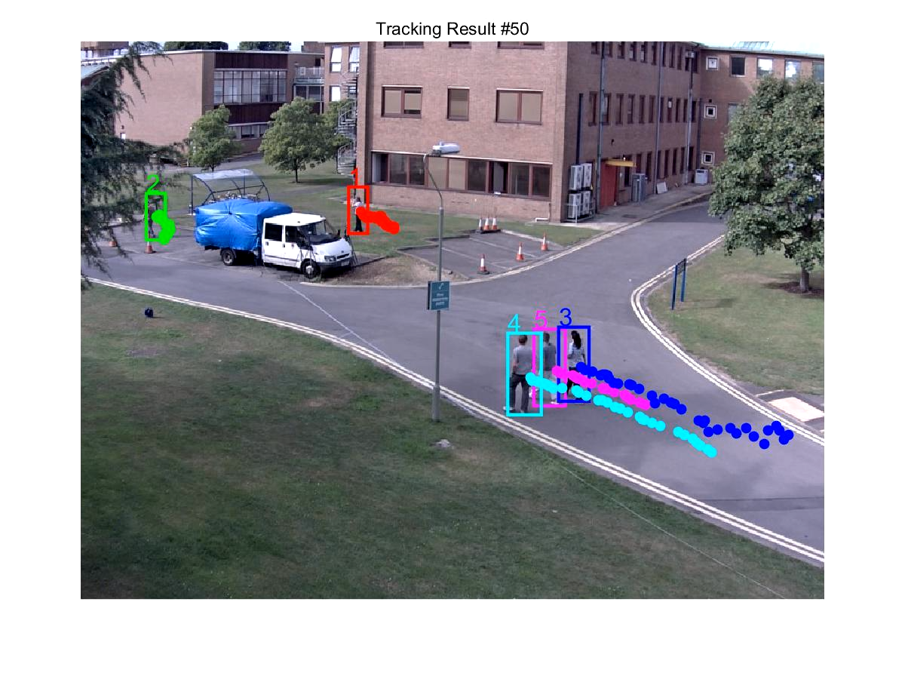
What is Multi-Person Tracking?
Multi-Person tracking (MPT) is to find the locations and sizes of multiple persons and conserve their identities (IDs) in image sequences.
ID
Location
(x, y)
Size
(width, height)

Slide 7
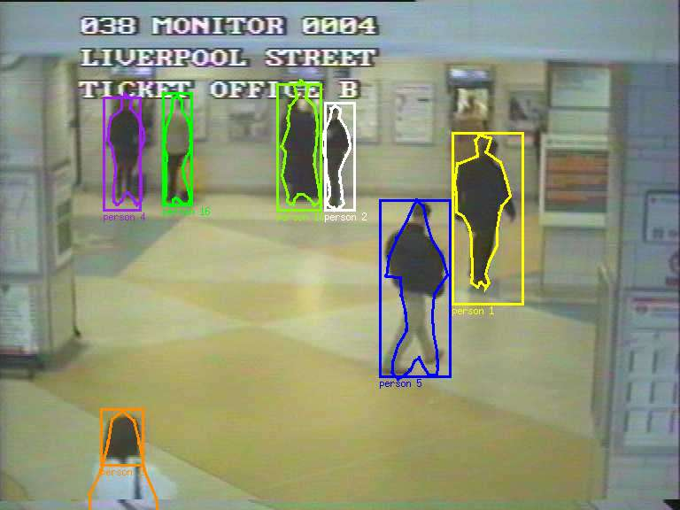
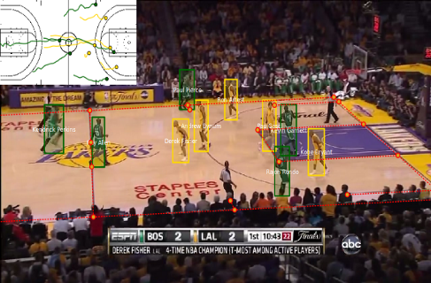
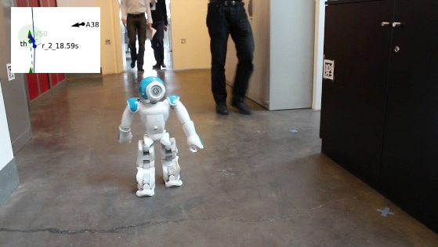
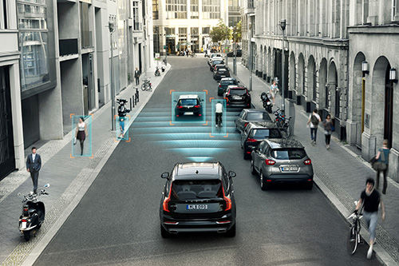
Why is MPT important?
Due to the rapid advancement of technologies, the amount of multimedia data is growing rapidly.
It is highly demanded to develop sophisticated methods to automatically process and understand multimedia data.
MPT is the foundation of many computer vision tasks.
pose estimation, people counting, action recognition, behavior analysis, abnormal event detection, and scene understanding
MPT has significant potential in various commercial applications.
<Visual surveillance>
<Sport analysis>
<Robot navigation>
<Autonomous driving>

Slide 8
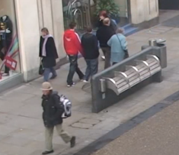
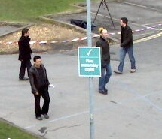
Challenges
The MPT problem in complex scenes is still challenging due to various issues.
1. Frequent and prolonged occlusions
2. Similar appearances of objects
occlusion between objects
occlusion by background objects
People dressed in similar clothing
<Occlusions>
<Similar appearances>

Slide 9
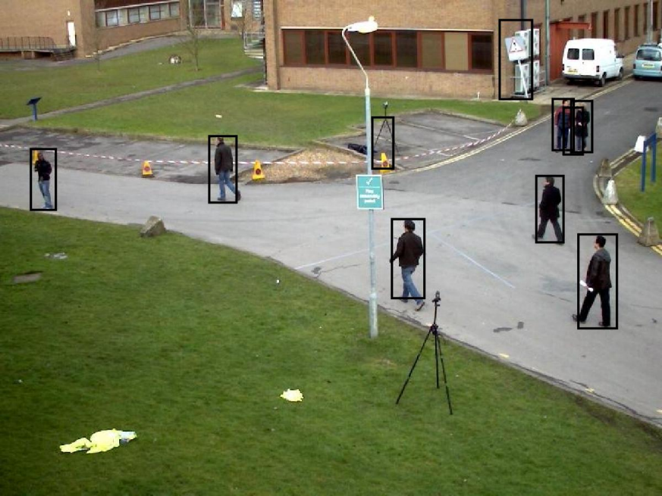
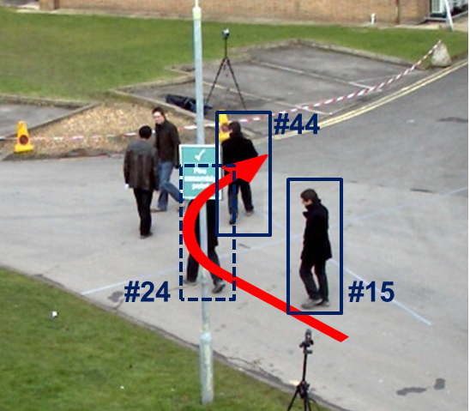
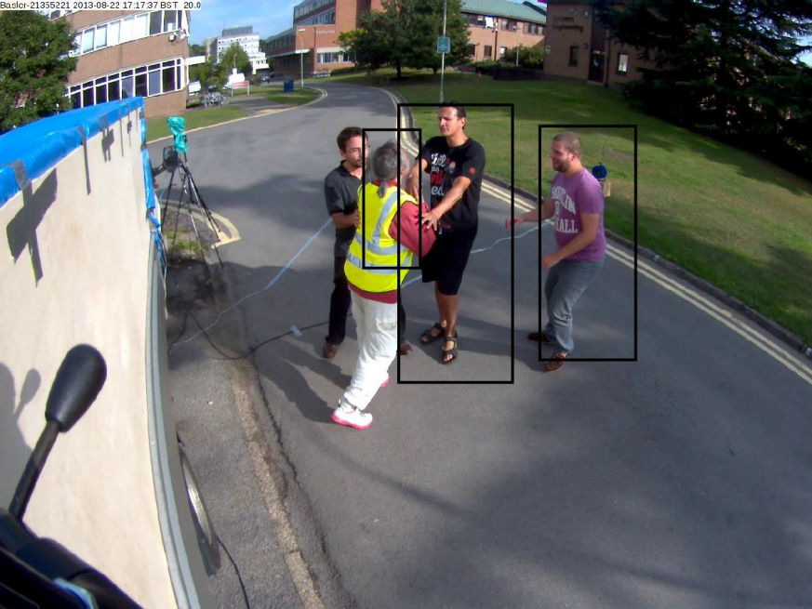
Challenges
The MPT problem in complex scenes is still challenging due to various issues.
3. Abrupt motion change
4. Unreliable detections (FP, FN, Inaccurate localization)
An occlusion with abrupt motion change situation
(#24,…, #40)
FP
FN
Inaccurate
position/size
<Abrupt motion change>
<Unreliable detection hypotheses>

Slide 10
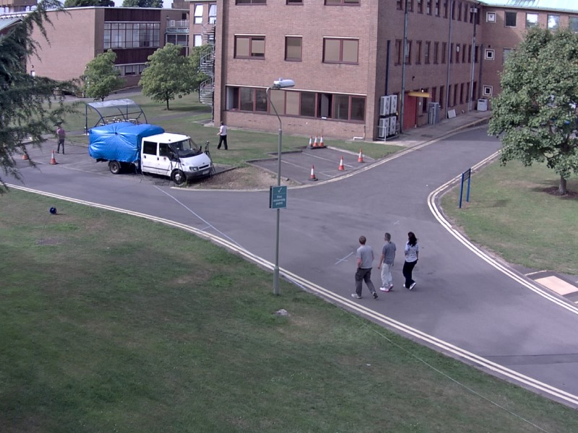
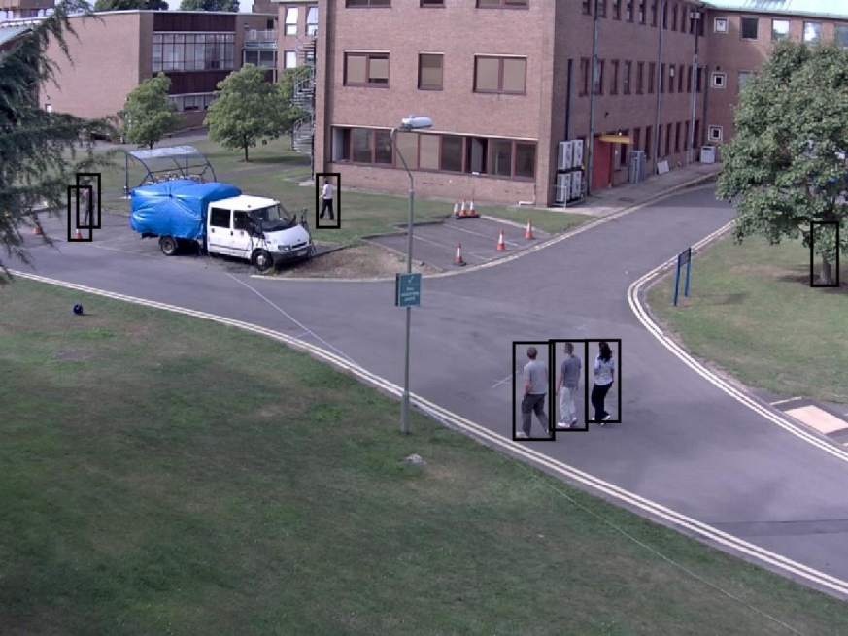
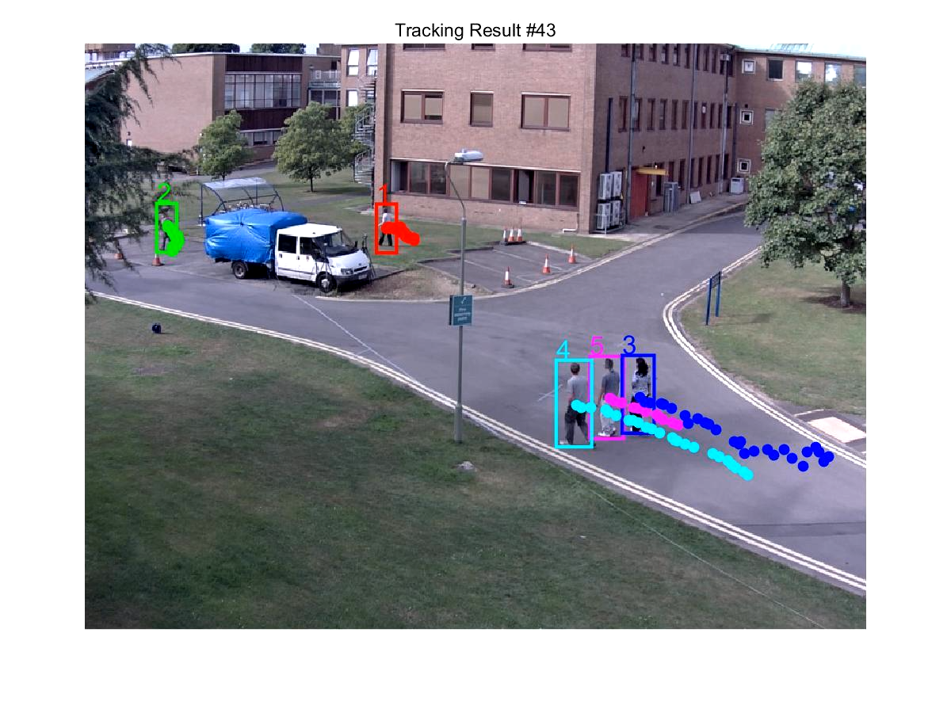
General MPT Approaches
Due to recent advances in object detectors, most recent MPT approaches have followed the Tracking-by-Detection strategy.
Detections are extracted independently in each frame by an object detector and they are matched to build object trajectories using data association.
<Image sequences>
<Detections>
<Tracking>
Data association
(Offline / Online)

Slide 11
Tracking-by-Detection Strategy
Categorization: Offline (Batch) vs. Online (Sequential)
Offline processing
Tracking at time t
…
…
available information
Online processing
Tracking at time t
…
…
available information
future information

Slide 12
Tracking-by-Detection Strategy
Categorization: Offline (Batch) vs. Online (Sequential)
Offline : It builds multiple trajectories by globally optimizing detections within the entire video or a large sliding window.
Online : It sequentially builds object trajectories based on frame-by-frame data association.
This research follows an online tracking-by-detection strategy which can be applied to online applications.
 | Accuracy / Robustness | Computational cost / Latency
Offline | High | Large
Online | Low | Small
<Summary of pros and cons>

Slide 13
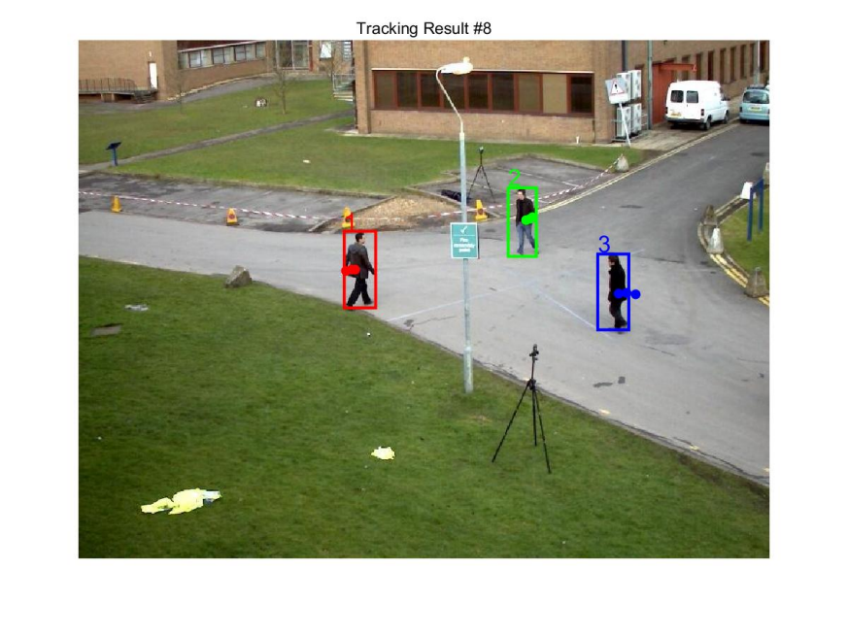
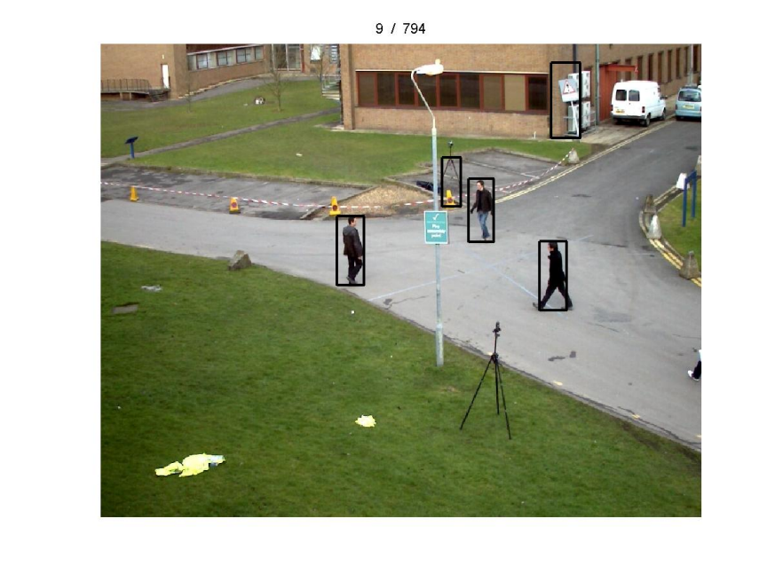
Major Issue
How to correctly assign current detections including errors to existing targets to sequentially track people?
FP
?
FP
Targets at frame t-1
Detections at frame t

Slide 14
Major Issue
Finding correct associations heavily relies on the affinity(=similarity) measurement between a target and a detection.
Possible cues: position, shape, appearance, motion, etc.
Appearance plays an important role in the recognition of different individuals. ➔ It is critical cue for affinity measurement.
Thus, this research mainly focuses on appearance modeling to provide accurate appearance affinities for robust multi-person tracking.

Slide 15
Previous Works & Limitations
Much work of online multi-person tracking has been devoted to the design of good appearance models [1-3].
They aim to learn the discriminativeness among targets by solving classification problems, and have shown the improvement of tracking performance on the strength of their appearance models.
Limitations of previous works
The underlying descriptors for representing target appearances only depend on hand-crafted features.
Haar-like features, color histograms, HOG, LBP
They are not able to capture more specific and complex characteristics of targets and thus struggle in challenging scenarios.
[1] M. D. Breitenstein, et al., “Online multiperson tracking-by-detection from a single, uncalibrated camera,” TPAMI, 2011.
[2] S. H. Bae and K. J. Yoon, “Robust online multiobject tracking with data association and track management,” TIP, 2014.
[3] G. Shu, et al., “Part-based multiple-person tracking with partial occlusion handling,” CVPR, 2012.

Slide 16
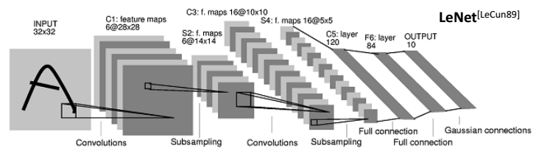
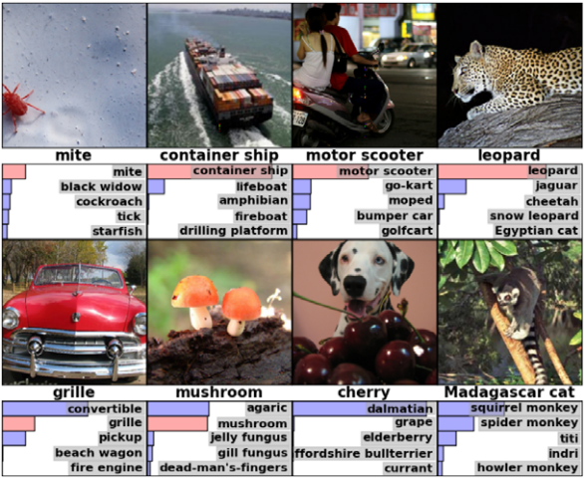
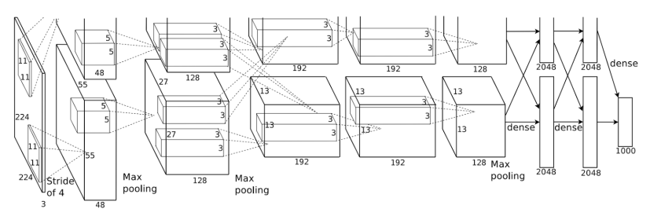
Convolutional Neural Network (CNN)
CNN recently draws a lot of attention due to its great success.
Reasons for recent success: (1) Availability of larger training datasets ( ImageNet), (2) Powerful GPUs, (3) Simple activation function (ReLU), (4) Better regularization methods (dropout, batch normalization)
Applications: image classification, object detection, object recognition
However, these techniques are not well exploited in multi-person tracking problem.
AlexNet (NIPS’12)

Slide 17
Motivation & Research Goal
Motivation
For robust multi-person tracking, it is desirable to exploit target-specific representations through a learning process rather than using a fixed set of pre-defined features.
Goal
Develop a novel appearance modeling by fully exploiting the representation power of CNN to improve appearance representation for discriminating different individuals.
Develop an online multi-person tracking algorithm robust to various scenarios by incorporating the proposed appearance model into an online tracking-by-detection strategy.
Develop a re-identification algorithm by appearance representation modeling to offer appropriate identifications of targets which re-enter at view of field.

Slide 18
2. Research Progress

Slide 19
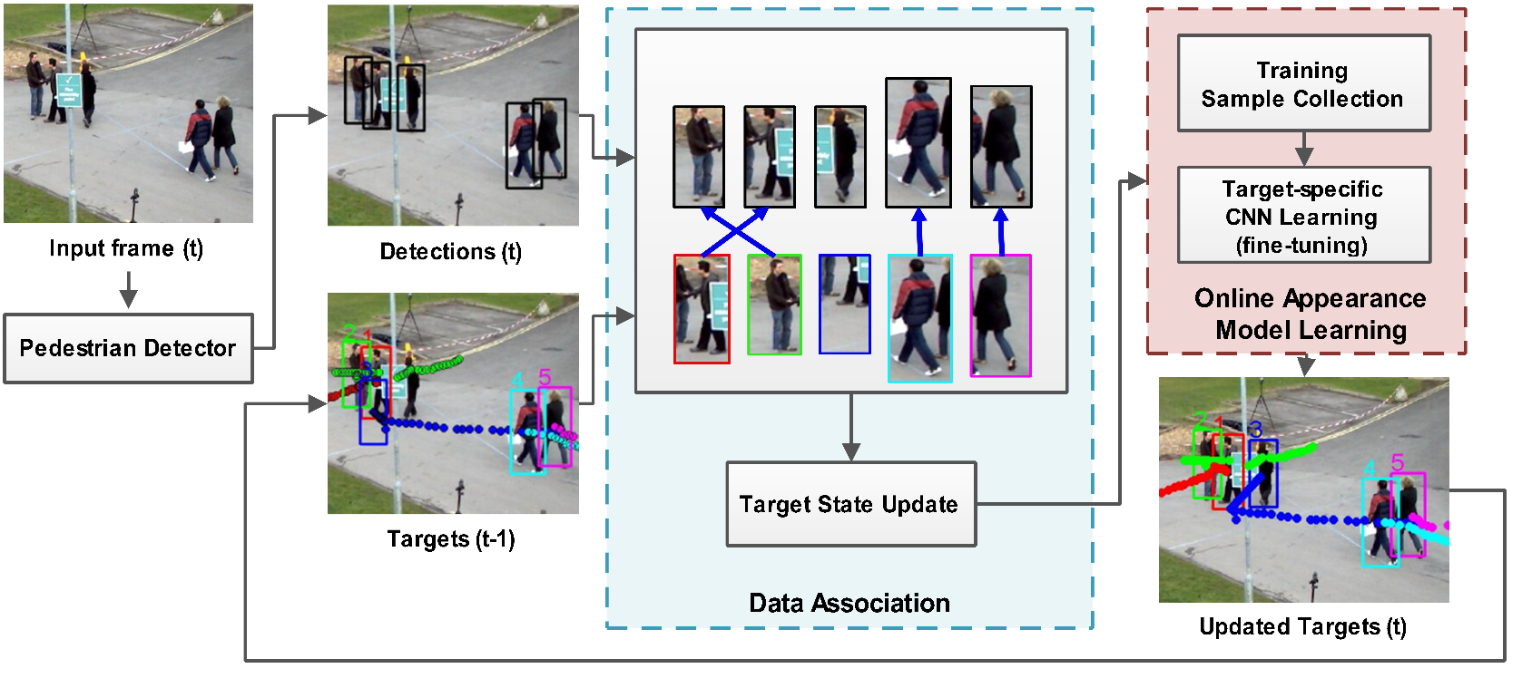
Overview
Proposed Multi-person Tracking Framework
Data association (DA)
At each frame, current detections are linked with existing targets by solving a data association problem based on the proposed affinities ➔ target trajectories are sequentially grown with the associated detections
Online appearance learning
Each target-specific network, which is pre-trained in offline stage, is fine-tuned using the collected samples for each target.

Slide 20
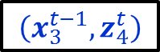
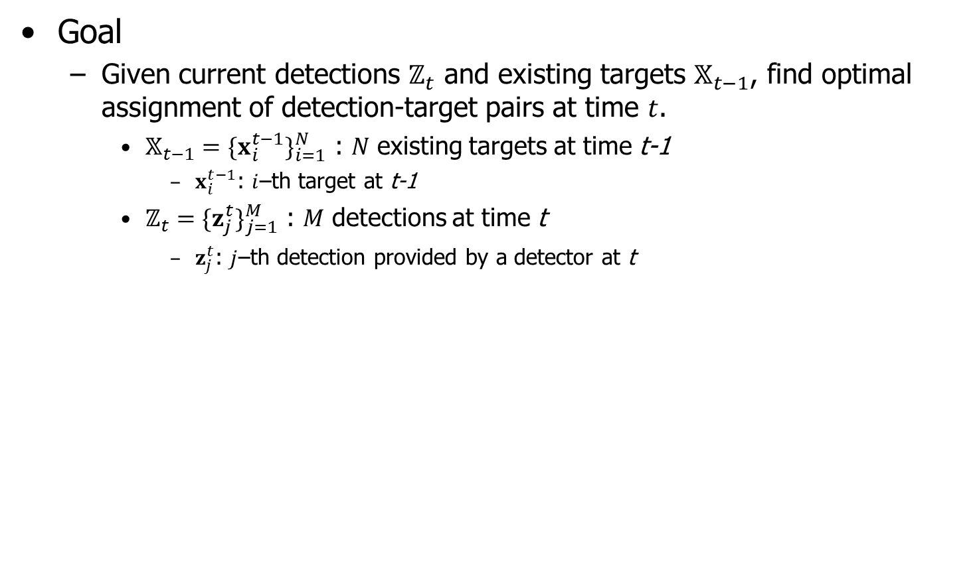
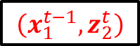
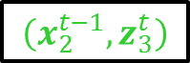
Data Association
Goal
Given current detections $ℤ_{t}$ and existing targets $𝕏_{t−1}$, find optimal assignment of detection-target pairs at time $t$.
$𝕏_{t−1}={\{x_{i}^{t−1}\}}_{i=1}^{N}$ : $N$ existing targets at time t-1
$x_{i}^{t−1}$: $i$–th target at t-1
$ℤ_{t}={\{z_{j}^{t}\}}_{j=1}^{M}$ : $M$ detections at time t
$z_{j}^{t}$: $j$–th detection provided by a detector at t
$$\left(x_{2}^{t−1},z_{3}^{t}\right)$$
$$\left(x_{1}^{t−1},z_{2}^{t}\right)$$
$$\left(x_{3}^{t−1},z_{4}^{t}\right)$$
Targets at time t-1
Detections at time t

Slide 21
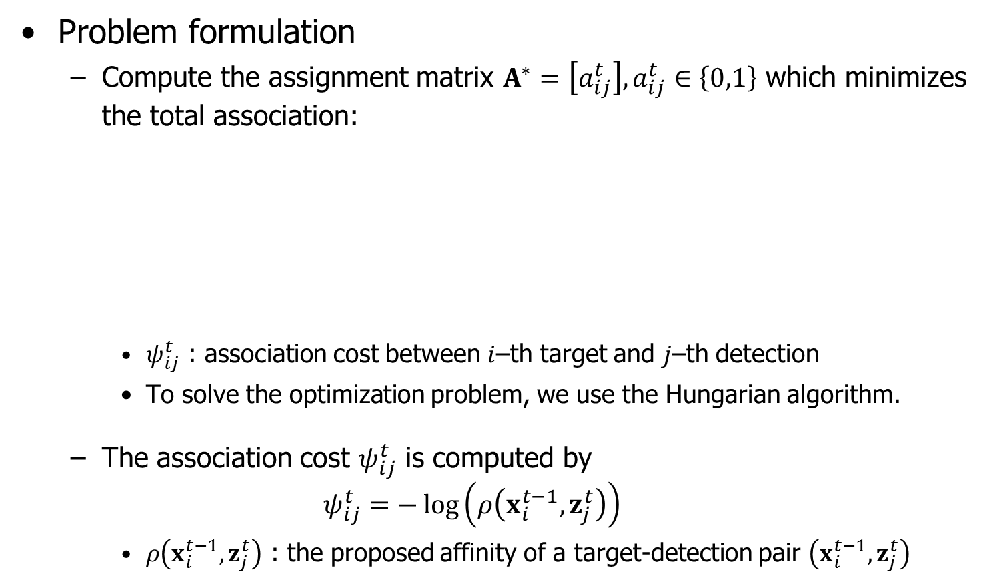
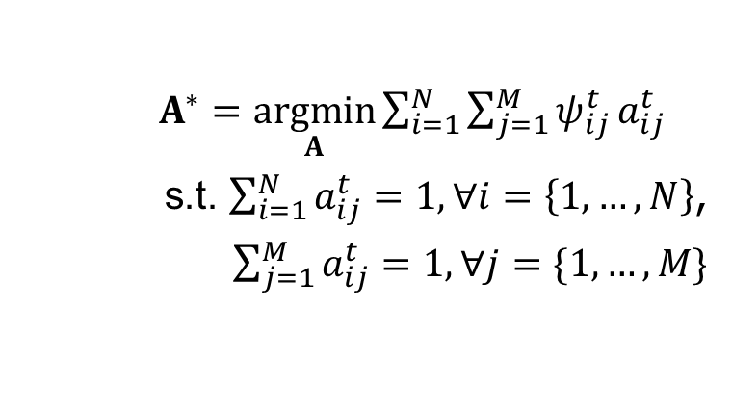
Data Association
Problem formulation
Compute the assignment matrix $A^{∗}=\left[a_{ij}^{t}\right],a_{ij}^{t}∈\left\{0,1\right\}$ which minimizes the total association:
$ψ_{ij}^{t}$ : association cost between $i$–th target and $j$–th detection
To solve the optimization problem, we use the Hungarian algorithm.
The association cost $ψ_{ij}^{t}$ is computed by
$$ψ_{ij}^{t}=−\log\left(ρ\left(x_{i}^{t−1},z_{j}^{t}\right)\right)$$
$ρ\left(x_{i}^{t−1},z_{j}^{t}\right)$ : the proposed affinity of a target-detection pair $\left(x_{i}^{t−1},z_{j}^{t}\right)$
$A^{∗}=\underset{A}{argmin}{\sum_{i=1}^{N}{\sum_{j=1}^{M}{ψ_{ij}^{t}}a_{ij}^{t}}}$
s.t. $\sum_{i=1}^{N}{a_{ij}^{t}}=1, ∀i=\left\{1,…,N\right\}$,
$\sum_{j=1}^{M}{a_{ij}^{t}}=1, ∀j=\{1,…,M\}$

Slide 22
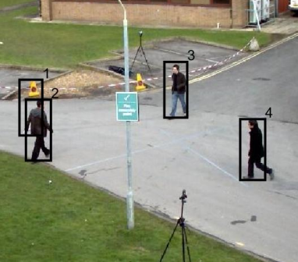
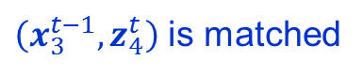
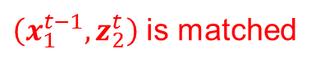
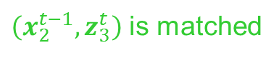
Data Association
Example of the DA process
$\left(x_{2}^{t−1},z_{3}^{t}\right)$ is matched
$\left(x_{1}^{t−1},z_{2}^{t}\right)$ is matched
$\left(x_{3}^{t−1},z_{4}^{t}\right)$ is matched
Tracks at frame t-1
Detections at frame t
0.12 | 0.65 | 0.00 | 0.00
0.00 | 0.00 | 0.74 | 0.00
0.00 | 0.00 | 0.00 | 0.72
2.12 | 0.43 | 0.00 | 0.00
0.00 | 0.00 | 0.30 | 0.00
0.00 | 0.00 | 0.00 | 0.40
0 | 1 | 0 | 0
0 | 0 | 1 | 0
0 | 0 | 0 | 1
Affinity matrix
Cost matrix
Assignment matrix

Slide 23
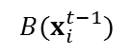
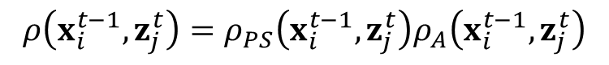
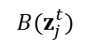
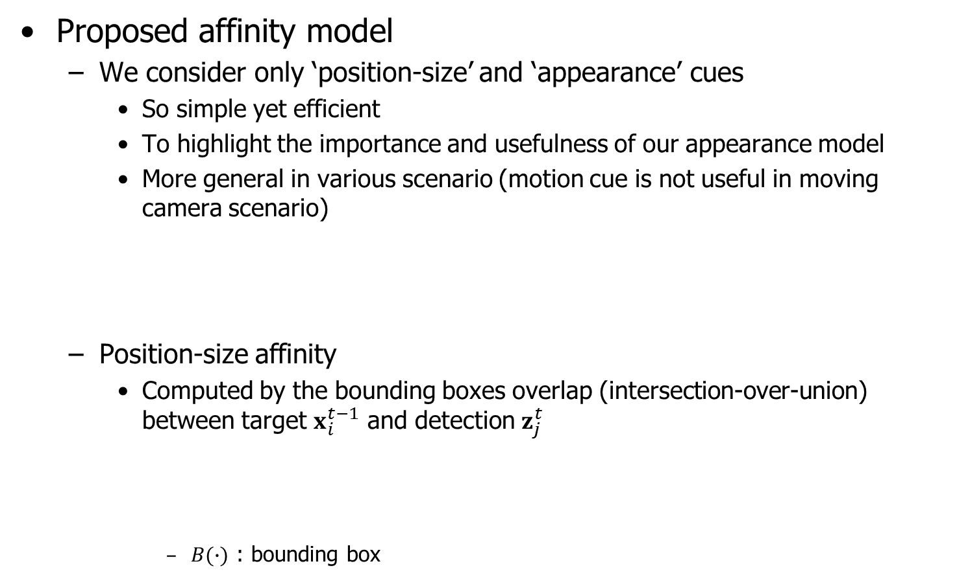
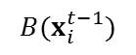
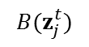
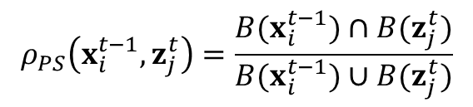
Data Association
Proposed affinity model
We consider only ‘position-size’ and ‘appearance’ cues
So simple yet efficient
To highlight the importance and usefulness of our appearance model
More general in various scenario (motion cue is not useful in moving camera scenario)
Position-size affinity
Computed by the bounding boxes overlap (intersection-over-union) between target $x_{i}^{t−1}$ and detection $z_{j}^{t}$
$B(∙)$ : bounding box
$$ρ\left(x_{i}^{t−1},z_{j}^{t}\right)=ρ_{PS}\left(x_{i}^{t−1},z_{j}^{t}\right)ρ_{A}\left(x_{i}^{t−1},z_{j}^{t}\right)$$
Position-size affinity term
Appearance affinity term
$$B(z_{j}^{t})$$
$$B(z_{j}^{t})$$
$$ρ_{PS}\left(x_{i}^{t−1},z_{j}^{t}\right)=\frac{B(x_{i}^{t−1})∩B(z_{j}^{t})}{B(x_{i}^{t−1})∪B(z_{j}^{t})}$$
$$B(x_{i}^{t−1})$$
$$B(x_{i}^{t−1})$$

Slide 24

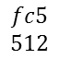
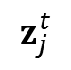
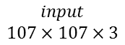
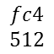
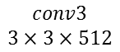

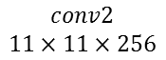
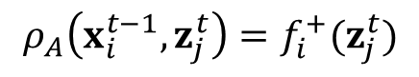
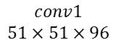
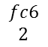

Data Association
Proposed affinity model
Appearance affinity
Computed by the positive output of the proposed target-specific network (CNN)
$$ρ_{A}\left(x_{i}^{t−1},z_{j}^{t}\right)=f_{i}^{+}(z_{j}^{t})$$
where $f_{i}^{+}\left(∙\right)∈[0,1]$ : positive score
$$z_{j}^{t}$$
positive output of target $x_{i}$’s CNN for an input patch of $z_{j}$ at time t
resized
$$fc6$$
$$2$$
Binary classification layer
(+) : the corresponding target
(-) : other targets or background
j-th detection
$$input$$
$$107×107×3$$
$$conv1$$
$$51×51×96$$
$$conv2$$
$$11×11×256$$
$$conv3$$
$$3×3×512$$
$$fc4$$
$$512$$
$$fc5$$
$$512$$
Target-specific network of i-th target

Slide 25


Proposed Appearance Modeling
Goal : To represent target appearances by fully exploiting the representation power of CNNs
Main idea : Training shared features and target‐specific classifiers jointly
Target 1
Shared feature representation
Target-specific classifiers
Target 2
Target 3
Transfer to a new target in a new sequence

Slide 26
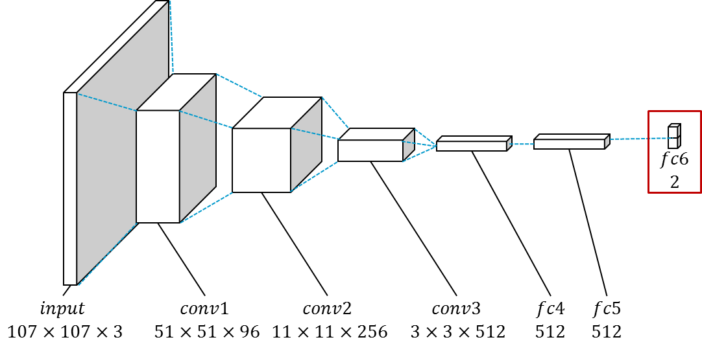
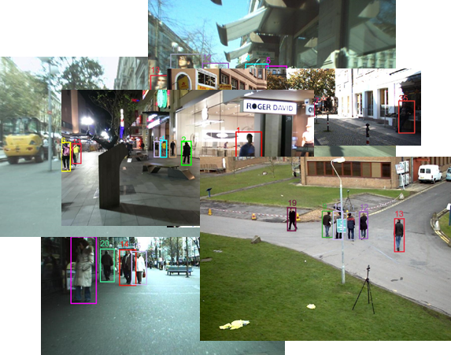
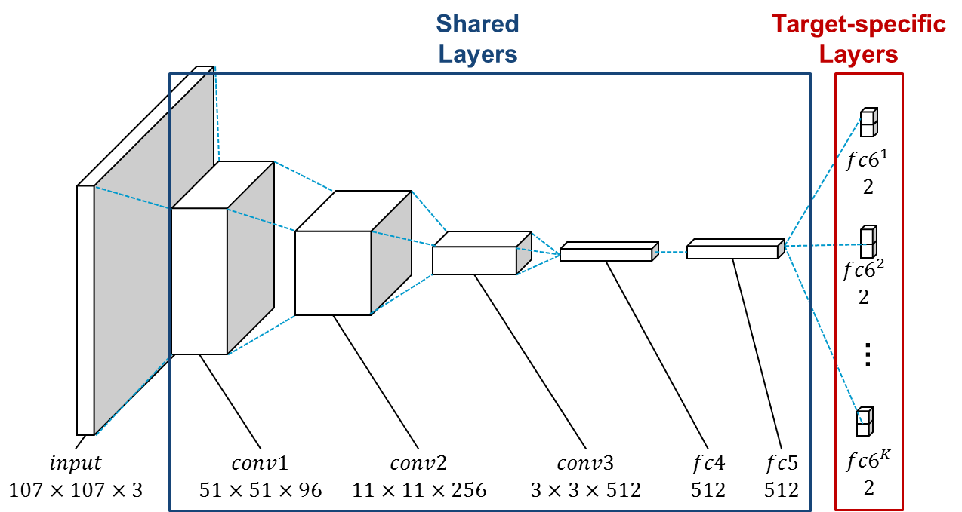
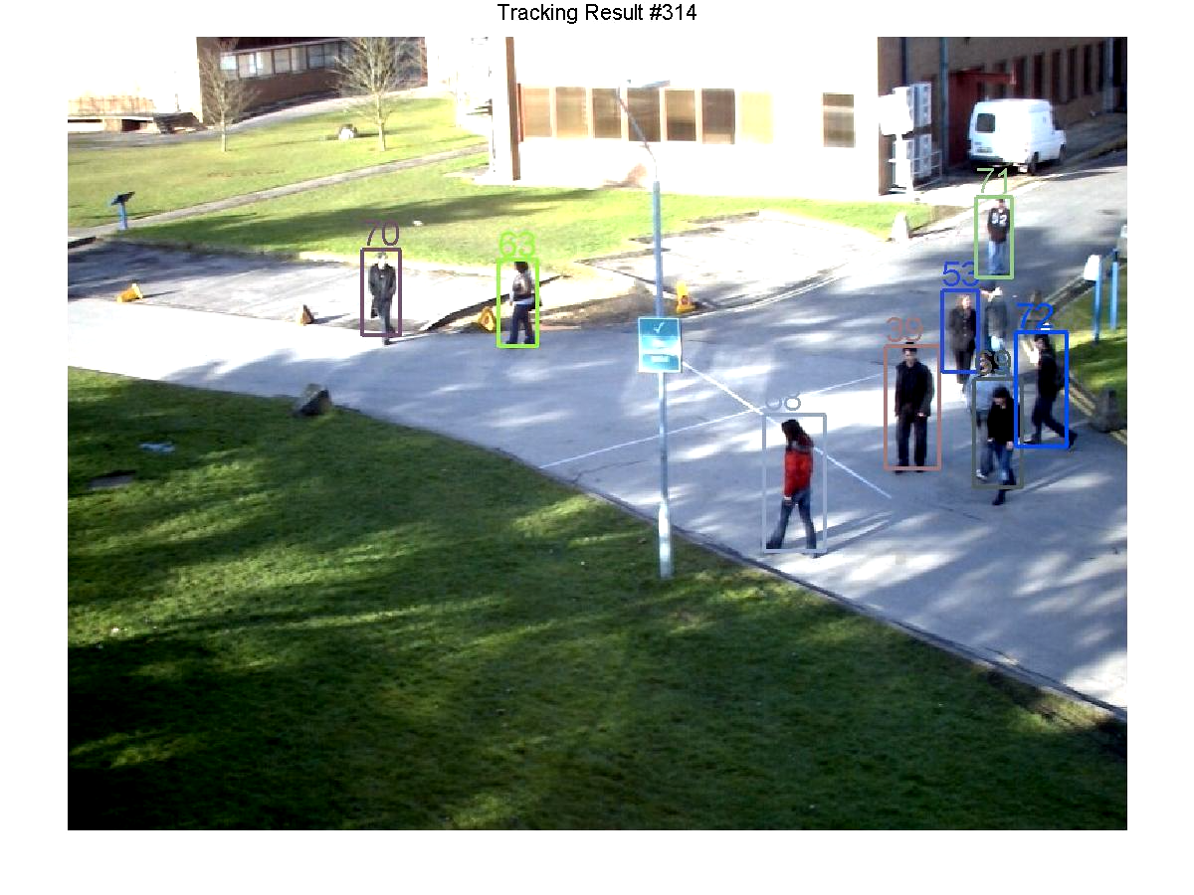
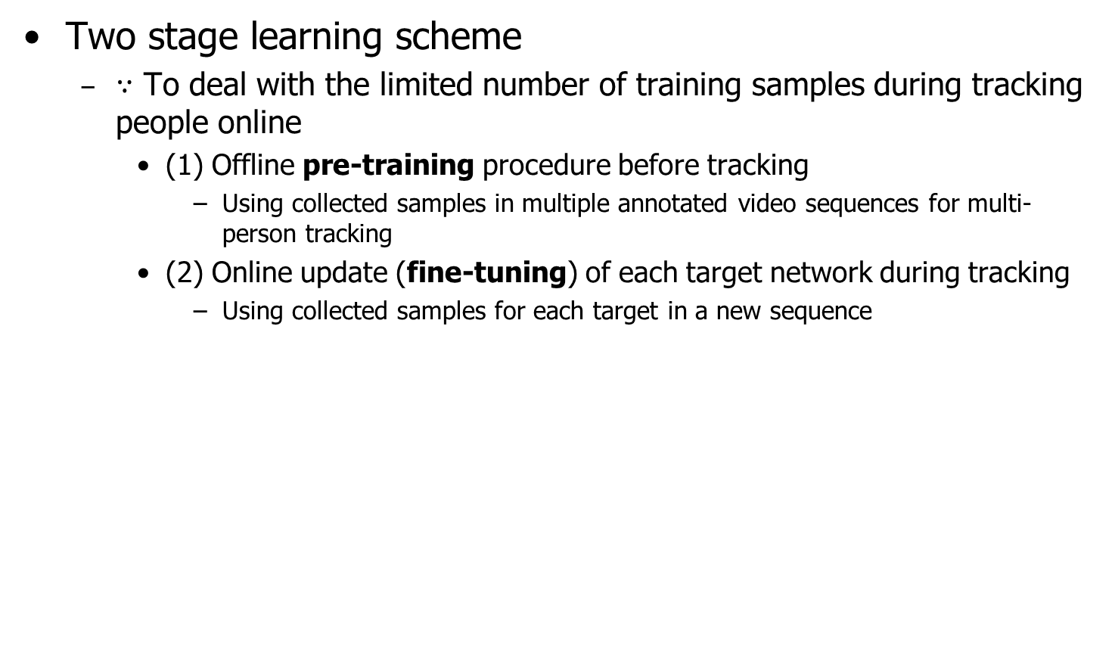
Proposed Appearance Modeling
Two stage learning scheme
$∵$ To deal with the limited number of training samples during tracking people online
(1) Offline pre-training procedure before tracking
Using collected samples in multiple annotated video sequences for multi-person tracking
(2) Online update (fine-tuning) of each target network during tracking
Using collected samples for each target in a new sequence
Offline pre-training stage
Online fine-tuning stage
pre-training
fine-tuning
•••
Training sequences with annotations
Test sequence
Proposed multi-target CNN
Target-specific networks

Slide 27









Proposed CNN architecture
Proposed Multi-target Network
Separating shared layers and target‐specific layers
Shared
Layers
Target-specific
Layers
$${fc6}^{1}$$
$$2$$
$${fc6}^{2}$$
$$2$$
…
$$input$$
$$107×107×3$$
$$conv1$$
$$51×51×96$$
$$conv2$$
$$11×11×256$$
$$conv3$$
$$3×3×512$$
$$fc4$$
$$512$$
$$fc5$$
$$512$$
$${fc6}^{K}$$
$$2$$
Share the common information captured from every person
Distinguishing the corresponding target from other targets

Slide 28

Proposed CNN architecture
Network configuration
Input layer
107x107 RGB (resized bounding box patch)
Shared layers:
3 convolution layers + 2 fully connected layers
Conv. 1-3 layers are identical to the corresponding parts of VGG-M network [4] (*feature map sizes are adjusted by our input size)
Fc. 4-5 layers are combined with ReLUs and dropouts
Target-specific layers
K binary classification layers with softmax cross-entropy loss
K : # of targets in all training sequences
VGG-M
[4] K. Chatfield, K. Simonyan, A. Vedaldi, and A. Zisserman, “Return of the Devil in the Details: Delving Deep into Convolutional Nets,” in British Machine Vision Conference, 2014.

Slide 29
Proposed CNN architecture
Features of the proposed network
Substantially smaller than the networks commonly used in visual recognition tasks (AlexNet and VGG-Nets)
More appropriate for multi-person tracking problem:
Each target network aims to distinguish only two classes: the corresponding target and other targets ➔ It requires much less model complexity than general visual recognition problems (e.g., ImageNet classification - 1000 object classes)
Targets are typically small ➔ It is desirable to make input size small which reduces the depth of the network naturally
Training and testing have to be performed online ➔ A smaller network is obviously more efficient
VGG-Net
AlexNet (NIPS’12)

Slide 30

Learning scheme
Goal
Train the proposed multi-target CNN to discriminate different people as well as background, thereby providing accurate appearance affinities
Pre-training process
Using stochastic gradient descent (SGD)
Each branch (${fc6}^{i}$) is handled exclusively in each iteration
In the k-th iteration, the network is updated based on a mini-batch that consists of the training samples of (k mod K)-th target, where only a single branch fc6^{(k mod K)} is enabled.
It is repeated until the network is converged or the predefined number of iterations (=100K) is reached.

Slide 31






Learning scheme
Training sample collection
Extract patches of all targets and their surrounding backgrounds for all frames in all training sequences
Construct pools of positive and negative samples for each target (each branch of the network)
1
2
Target samples
3
Training sequences with GTs
Background samples
Pool of positive samples
Pool of negative samples

Slide 32









Learning scheme
Network pre-training
In the k-th iteration, a single branch fc6^{(k mod K)} is only enabled
Shared
Layers
Target-specific
Layers
1
Training
CNN
$${fc6}^{1}$$
$$2$$
2
$${fc6}^{2}$$
$$2$$
Training
CNN
…
3
Training
CNN
$$input$$
$$107×107×3$$
$$conv1$$
$$51×51×96$$
$$conv2$$
$$11×11×256$$
$$conv3$$
$$3×3×512$$
$$fc4$$
$$512$$
$$fc5$$
$$512$$
$${fc6}^{K}$$
$$2$$
…

Slide 33










Online appearance learning
Proposed target-specific network for online tracking
Construct a new network for each target during tracking
All the existing branches (${fc6}^{1}$,…,${fc6}^{K}$) in the offline training phase are removed and a new single branch is combined with the shared layers.
Transfer shared features
$f_{i}^{+}\left(∙\right)$: positive output
$f_{i}^{−}\left(∙\right)$: negative output
$$fc6$$
$$2$$
New single branch
➔ Distinguish the corresponding target and other targets
$$input$$
$$107×107×3$$
$$conv1$$
$$51×51×96$$
$$conv2$$
$$11×11×256$$
$$conv3$$
$$3×3×512$$
$$fc4$$
$$512$$
$$fc5$$
$$512$$

Slide 34




















Online appearance learning
Online network update process
Each target-specific network is updated in regular intervals using the collected samples for each target throughout tracking
Only the weights in fc4-6 are updated whereas the ones in the conv1-3 are fixed ⬅ $∵$ to preserve target-independent information & more efficient
Target
Network
ID-1
DA
ID-1
$$fc6$$
$$2$$
Fine-tuning
Target
Network
ID-2
$$input$$
$$107×107×3$$
$$conv1$$
$$51×51×96$$
$$conv2$$
$$11×11×256$$
$$conv3$$
$$3×3×512$$
$$fc4$$
$$512$$
$$fc5$$
$$512$$
ID-2
$$fc6$$
$$2$$
Fine-tuning
Target
Network
ID-3
$$input$$
$$107×107×3$$
$$conv1$$
$$51×51×96$$
$$conv2$$
$$11×11×256$$
$$conv3$$
$$3×3×512$$
$$fc4$$
$$512$$
$$fc5$$
$$512$$
ID-3
Online training sample collection
$$fc6$$
$$2$$
Fine-tuning
$$input$$
$$107×107×3$$
$$conv1$$
$$51×51×96$$
$$conv2$$
$$11×11×256$$
$$conv3$$
$$3×3×512$$
$$fc4$$
$$512$$
$$fc5$$
$$512$$
•••
•••

Slide 35


Re-identification
The re-identification based on appearance model
In the target termination step, instead of immediately terminating targets leaving the filed of view, we deactivate these target during a certain period of time to recognize re-entering targets.
Their appearance model information (target-specific classifier) is kept during a certain period of time.
In the target initialization step, instead of immediately initializing a new target, we examine whether a target previously existed using the classifier of each deactivated target.
Target Classifier
ID#3
(-)
ID:6
ID:6
Target Classifier
ID#6
(+)
Target Classifier
ID#8
(-)
Deactivate target ID#6
Target classifiers of deactivated targets
An illustration of the re-identification process

Slide 36
Re-identification
Proposed re-identification model
When targets leave the view of field, target’s model will be put into lost target model pool. When a detection is failed to be data associated, it will be marked “unmatched detection” and sent to appearance only data association model to get assignment matrix between “lost target” and “unmatched detection”, the re-identification result shows in the matrix.

Slide 37
3. Experiments & Demo

Slide 38






Datasets
Multiple Object Tracking Challenge (MOTC) [5]
Total 22 sequences (Training = 11 / Testing = 11)
Each sequence has different characteristics
frame rate, pedestrian density, illumination, point of view
PETS’09 S2.L1
Venice-1
Town-Centre
KITTI-16
ADL-Rundle-3
[5] L. Leal-Taix´, et al., “MOTChallenge 2015: Towards a Benchmark for Multi-Target Tracking”, arXiv, 2015.

Slide 39

Detections
Public detections provided by MOTC are used
For fair comparison with other methods which used the public detections
Detector: Aggregate Channel Features (ACF) [5]
Pre-trained INRIA model is used
Detector performance (Precision / Recall)
Training set→ 60% / 52%, Test set→ 60% / 46%
<Exemplar detection results>
[5] P. Dollar, et al., “Fast feature pyramids for object detection”, TPAMI 2014.

Slide 40


Discriminative power of Appearance model
Validation dataset for performance analysis
Separate a validation set of 6 sequences from the 11 training sequences ($∵$ annotations of the test set are not provided from MOTC)
Baselines for comparison
Hand-crafted features + SVM classifier
RGB / LBP / HOG / RGB+LBP+HOG
Training process (training samples & update interval) is the same as our method (CNN)

Slide 41

Discriminative power of Appearance model
Metrics for evaluating discriminative power of appearance model
${DP}_{1}=ρ_{A}\left(x_{i},z_{j^{∗}}\right)−ρ_{A}\left(x_{i},z_{\tilde{j}}\right)$
${DP}_{2}=log\frac{ρ_{A}\left(x_{i},z_{j^{∗}}\right)}{ρ_{A}\left(x_{i},z_{\tilde{j}}\right)}$
$\left(x_{i},z_{j^{∗}}\right)$ : correct target-detection pair
$\left(x_{i},z_{\tilde{j}}\right) where \tilde{j}=arg\max_{j≠j∗}{ρ_{A}\left(x_{i},z_{j}\right)}$ : incorrect target-detection pair with the highest appearance score
➔ The larger ${DP}_{1}$ and ${DP}_{2}$, the better the appearance can distinguish targets
Difference between the appearance score for a correct and the other targets

Slide 42


Discriminative power of Appearance model
Average results on a validation dataset
The proposed appearance model based on CNN outperforms others based on hand-crafted features in terms of all metrics.
➔ Our model better represents the target appearances by exploiting CNN and online target-specific learning
$${DP}_{1}$$
$${DP}_{2}$$

Slide 43



Evaluation metrics
Performance evaluation for multi-target tracking
Metric | Description
MOTA ($↑$) | Multi-object tracking accuracy : $$MOTA=1−\frac{\sum_{t}{{FP}_{t}+{FN}_{t}+{IS}_{t}}}{\sum_{t}{{GT}_{t}}}$$
MOTP ($↑$) | Multi-object tracking precision : $$MOTP=1−\frac{\sum_{t,i}{d_{t,i}}}{\sum_{t}{c_{t}}}$$
MT ($↑$) | Percentages GT tracks covered by tracker $≥$ 80%
ML ($↓$) | Percentages GT tracks covered by tracker $≤$ 20%
IDS ($↓$) | The number of ID switching
${FP}_{t}$: # of false positives at t
${FN}_{t}$: # of missed targets at t
${IS}_{t}$ : # of identity switches at t
${GT}_{t}$ : # of ground truth objects at t
$c_{t}$ : # of matches in frame t
$d_{t,i}$ : bounding box overlap of target i with its assigned ground truth object

Slide 44
Tracking performance comparison
Average results on the test sequences of the MOTC dataset
Methods |  | MOTA (%) | MOTP (%) | MT(%) | ML (%) | IDS
Online | Proposed | 30.9 | 70.1 | 9.40 | 43.70 | 484
 | SCEA [5] | 29.1 | 71.1 | 8.90 | 47.30 | 604
 | oICF [6] | 27.1 | 70 | 6.40 | 48.70 | 454
 | TC_ODAL [7] | 15.1 | 70.5 | 3.20 | 55.80 | 637
 | RMOT [8] | 18.6 | 69.6 | 5.30 | 53.30 | 684
Offline | NOMT [9] | 33.7 | 71.9 | 12.20 | 44.00 | 442
 | LP_SSVM [10] | 25.2 | 71.7 | 5.80 | 53.00 | 646
 | MotiCon [11] | 23.1 | 70.9 | 4.70 | 52.00 | 1,018
 | SegTrack [12] | 22.5 | 71.7 | 5.80 | 63.90 | 697
 | DCO_X [13] | 19.6 | 71.4 | 5.10 | 54.90 | 521
[5] Hong Yoon, J., et al., ”Online Multi-object Tracking via Structural Constraint Event Aggregation”, CVPR 2016.
[6] Kieritz, S., et al., ”Online Multi-Person Tracking using Integral Channel Features”, AVSS 2016.
[7] Bae, S. H., et. al., ”Robust Online Multi-Object Tracking based on Tracklet Confidence and Online Discriminative Appearance Learning”, CVPR 2014.
[8] Yoon, J. H., et al., ”Bayesian Multi-Object Tracking Using Motion Context from Multiple Objects”, WACV 2015
[9] Choi, W. “Near-online multi-target tracking with aggregated local flow descriptor”, ICCV 2015.
[10] Wang, S., et al., “Learning Optimal Parameters for Multi-target Tracking with Contextual Interactions”, IJCV 2016.
[11] Leal-Taixé, L., et al., “Learning an image-based motion context for multiple people tracking”, CVPR 2014.
[12] A. Milan, et al., ”Joint Tracking and Segmentation of Multiple Targets”, CVPR 2015.
[13] A. Milan, et al., ”Multi-Target Tracking by Discrete-Continuous Energy Minimization”, TPAMI 2016.

Slide 45
Tracking performance comparison
Average results on the test sequences of the MOTC dataset
Outperforms other online state-of-art methods for most metrics
Shows almost the same or even better performance compared to the offline methods
This improvement is achieved without using future frames (no latency) and without a sophisticated and complex association framework ➔ Shows the effectiveness of the proposed appearance modeling based on CNN
Methods |  | MOTA (%) | MOTP (%) | MT(%) | ML (%) | IDS
Online | Proposed | 30.9 | 70.1 | 9.40 | 43.70 | 484
 | SCEA [5] | 29.1 | 71.1 | 8.90 | 47.30 | 604
 | oICF [6] | 27.1 | 70 | 6.40 | 48.70 | 454
 | TC_ODAL [7] | 15.1 | 70.5 | 3.20 | 55.80 | 637
 | RMOT [8] | 18.6 | 69.6 | 5.30 | 53.30 | 684
*Bold: Best results in online approaches

Slide 46
Re-identification performance
Evaluate performance on PETS09-S2L1 sequence of the MOTC dataset
PETS09-S2L1 is the only suitable sequence in MOTC for testing re-identification because re-enter events occur frequently.
*IDs here are offered by dataset for the target enter field of view first time
ID* | Re-enter times | (Leaving, re-enter) frame | Re-identification success times | Success rate(%)
19 | 1 | (147, 224) | 1 | 100
15 | 3 | (206,231) (404,505) (613,697) | 3 | 100
9 | 1 | (519,576) | 1 | 100
12 | 1 | (362,507) | 0 | 0
11 | 1 | (367,529) | 0 | 0
13 | 1 | (393,467) | 1 | 100
10 | 1 | (577,611) | 1 | 100
16 | 0 | - | - | -
17 | 0 | - | - | -
7 | 0 | - | - | -
Total | 9 | - | 7 | 77.78

Slide 47
Re-identification performance
Comparing performance on PETS09-S2L1 sequence of the MOTC dataset
Gain improvement of accuracy and MT, because re-identification algorithm corrects the wrong labels which are given by tracking algorithm.
PETS09-S2L1 distinguishes the target which leave and re-enter at view of field so it offers different labels for the targets above. For testing re-identification algorithm, it is necessary to modify the ground true by hand to give proper labels to targets.
Re-identification (On/Off) | MOTA (%) | MOTP (%) | MT(%) | ML (%) | IDS
On | 78.9 | 71.2 | 100 | 0 | 19
Off | 78.4 | 71.2 | 94.7 | 0 | 22

Slide 48

Tracking Demo

Slide 49
4. Further works

Slide 50
Further works
Task 1: Develop the visual-based online multi-person tracking algorithm
People re-identification based on the proposed appearance model for recognizing subjects who re-appear in the same scene or appear in other scenes (multi-camera application).
Task 2: Develop the audio-visual multi-speaker tracking algorithm
Audio source localization for estimating speaker’s location from audio signals in microphones array.
Fusion strategy incorporating the information of local (audio/visual) targets to estimate the states of global (audio + visual) targets.

Slide 51
Integrated Master Schedule
Subject | Detail subject | 2016 |  |  |  | 2017
 |  | 9 | 10 | 11 | 12 | 1 | 2 | 3 | 4 | 5 | 6 | 7 | 8
Survey and Literature Search | Related works about multi-person tracking
 | Multi-hypotheses association algorithms for fusion module in a multi-speaker tracking algorithm
Implement baseline system | Implement conventional tracking algorithms (hand-craft feature based appearance learning)
Develop new and enhanced approaches | Develop an online appearance model learning algorithm using DCNN
 | Develop an online multi-person tracking-by-detection algorithm
 | Develop a Re-identification algorithm based on the developed appearance model
 | Develop an improved audio source localization algorithm
 | Develop a multi-speaker tracking algorithm by incorporating each single-modal tracking module and fusion module
Performance evaluation | Evaluate the proposed visual-based multi-person tracking algorithm
 | Evaluate the proposed audio-visual based multi-speaker tracking algorithm
: Completed
: Planned

